Slide 1
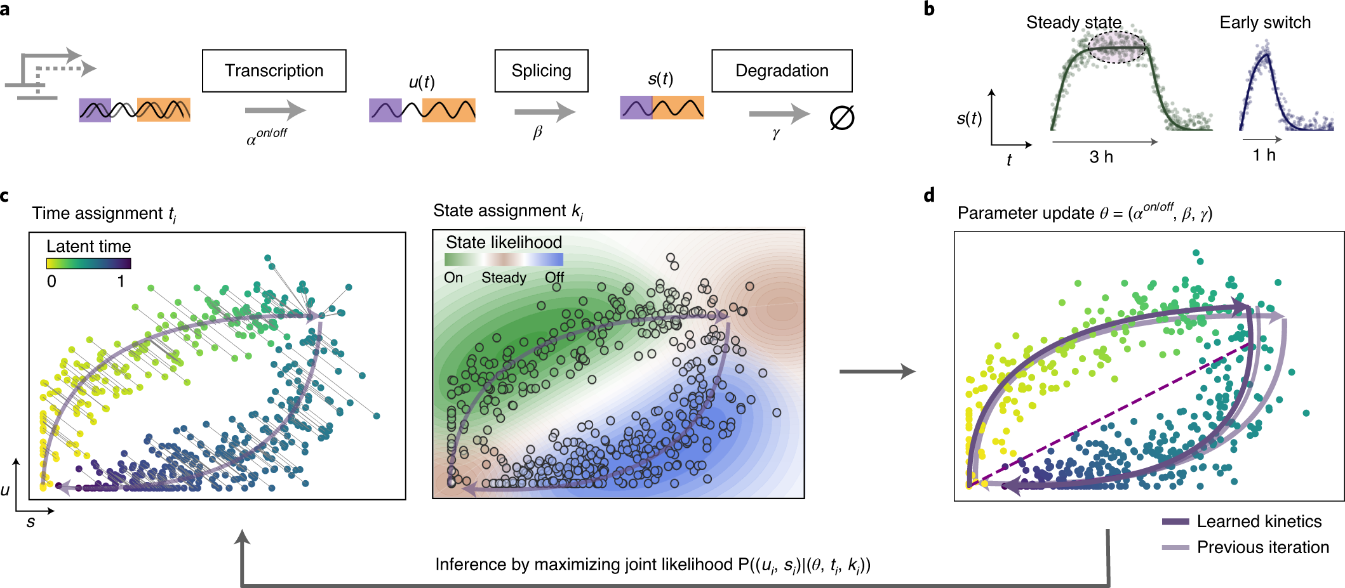

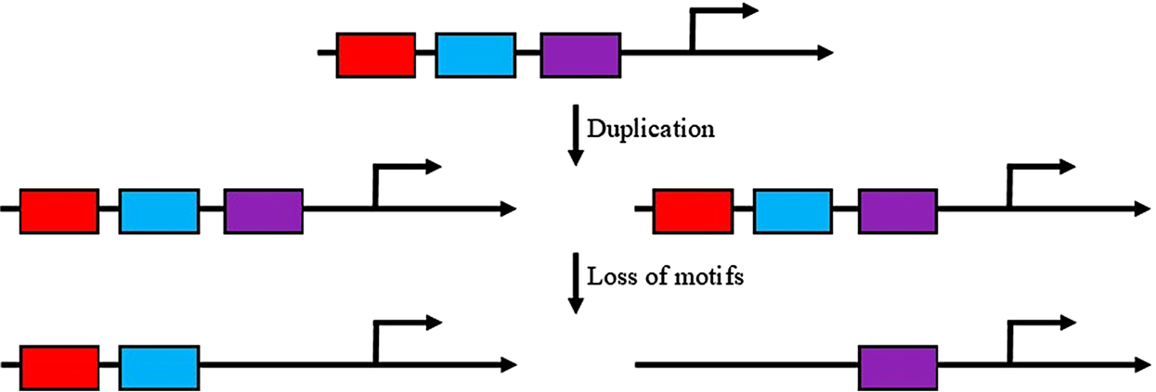
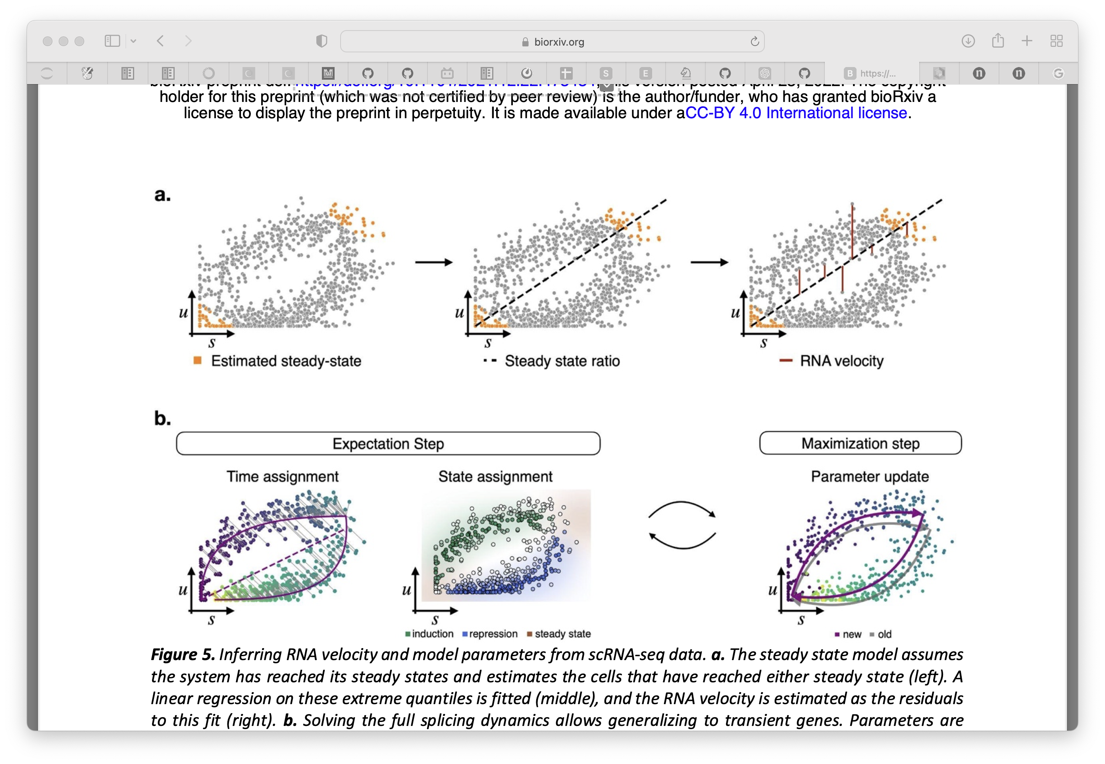

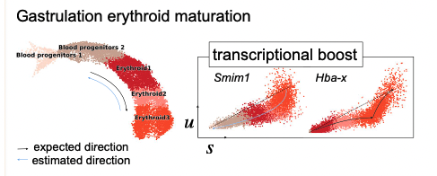

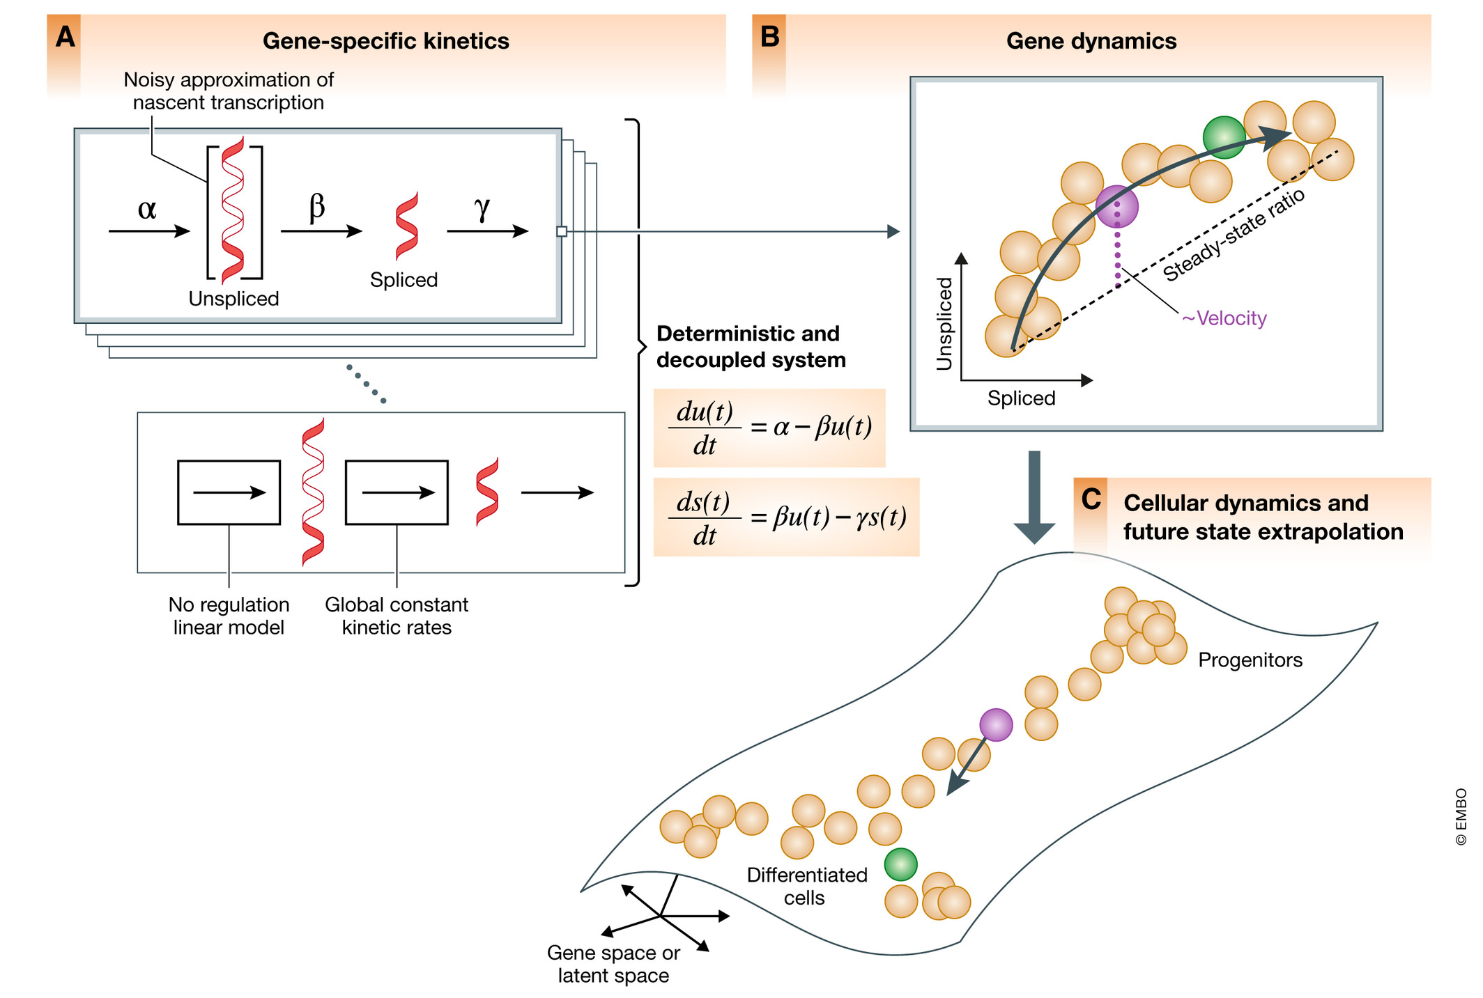
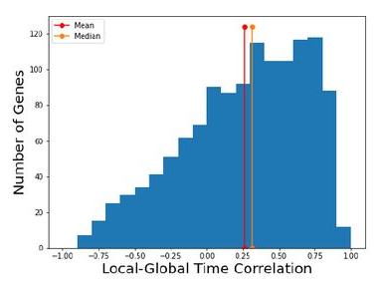
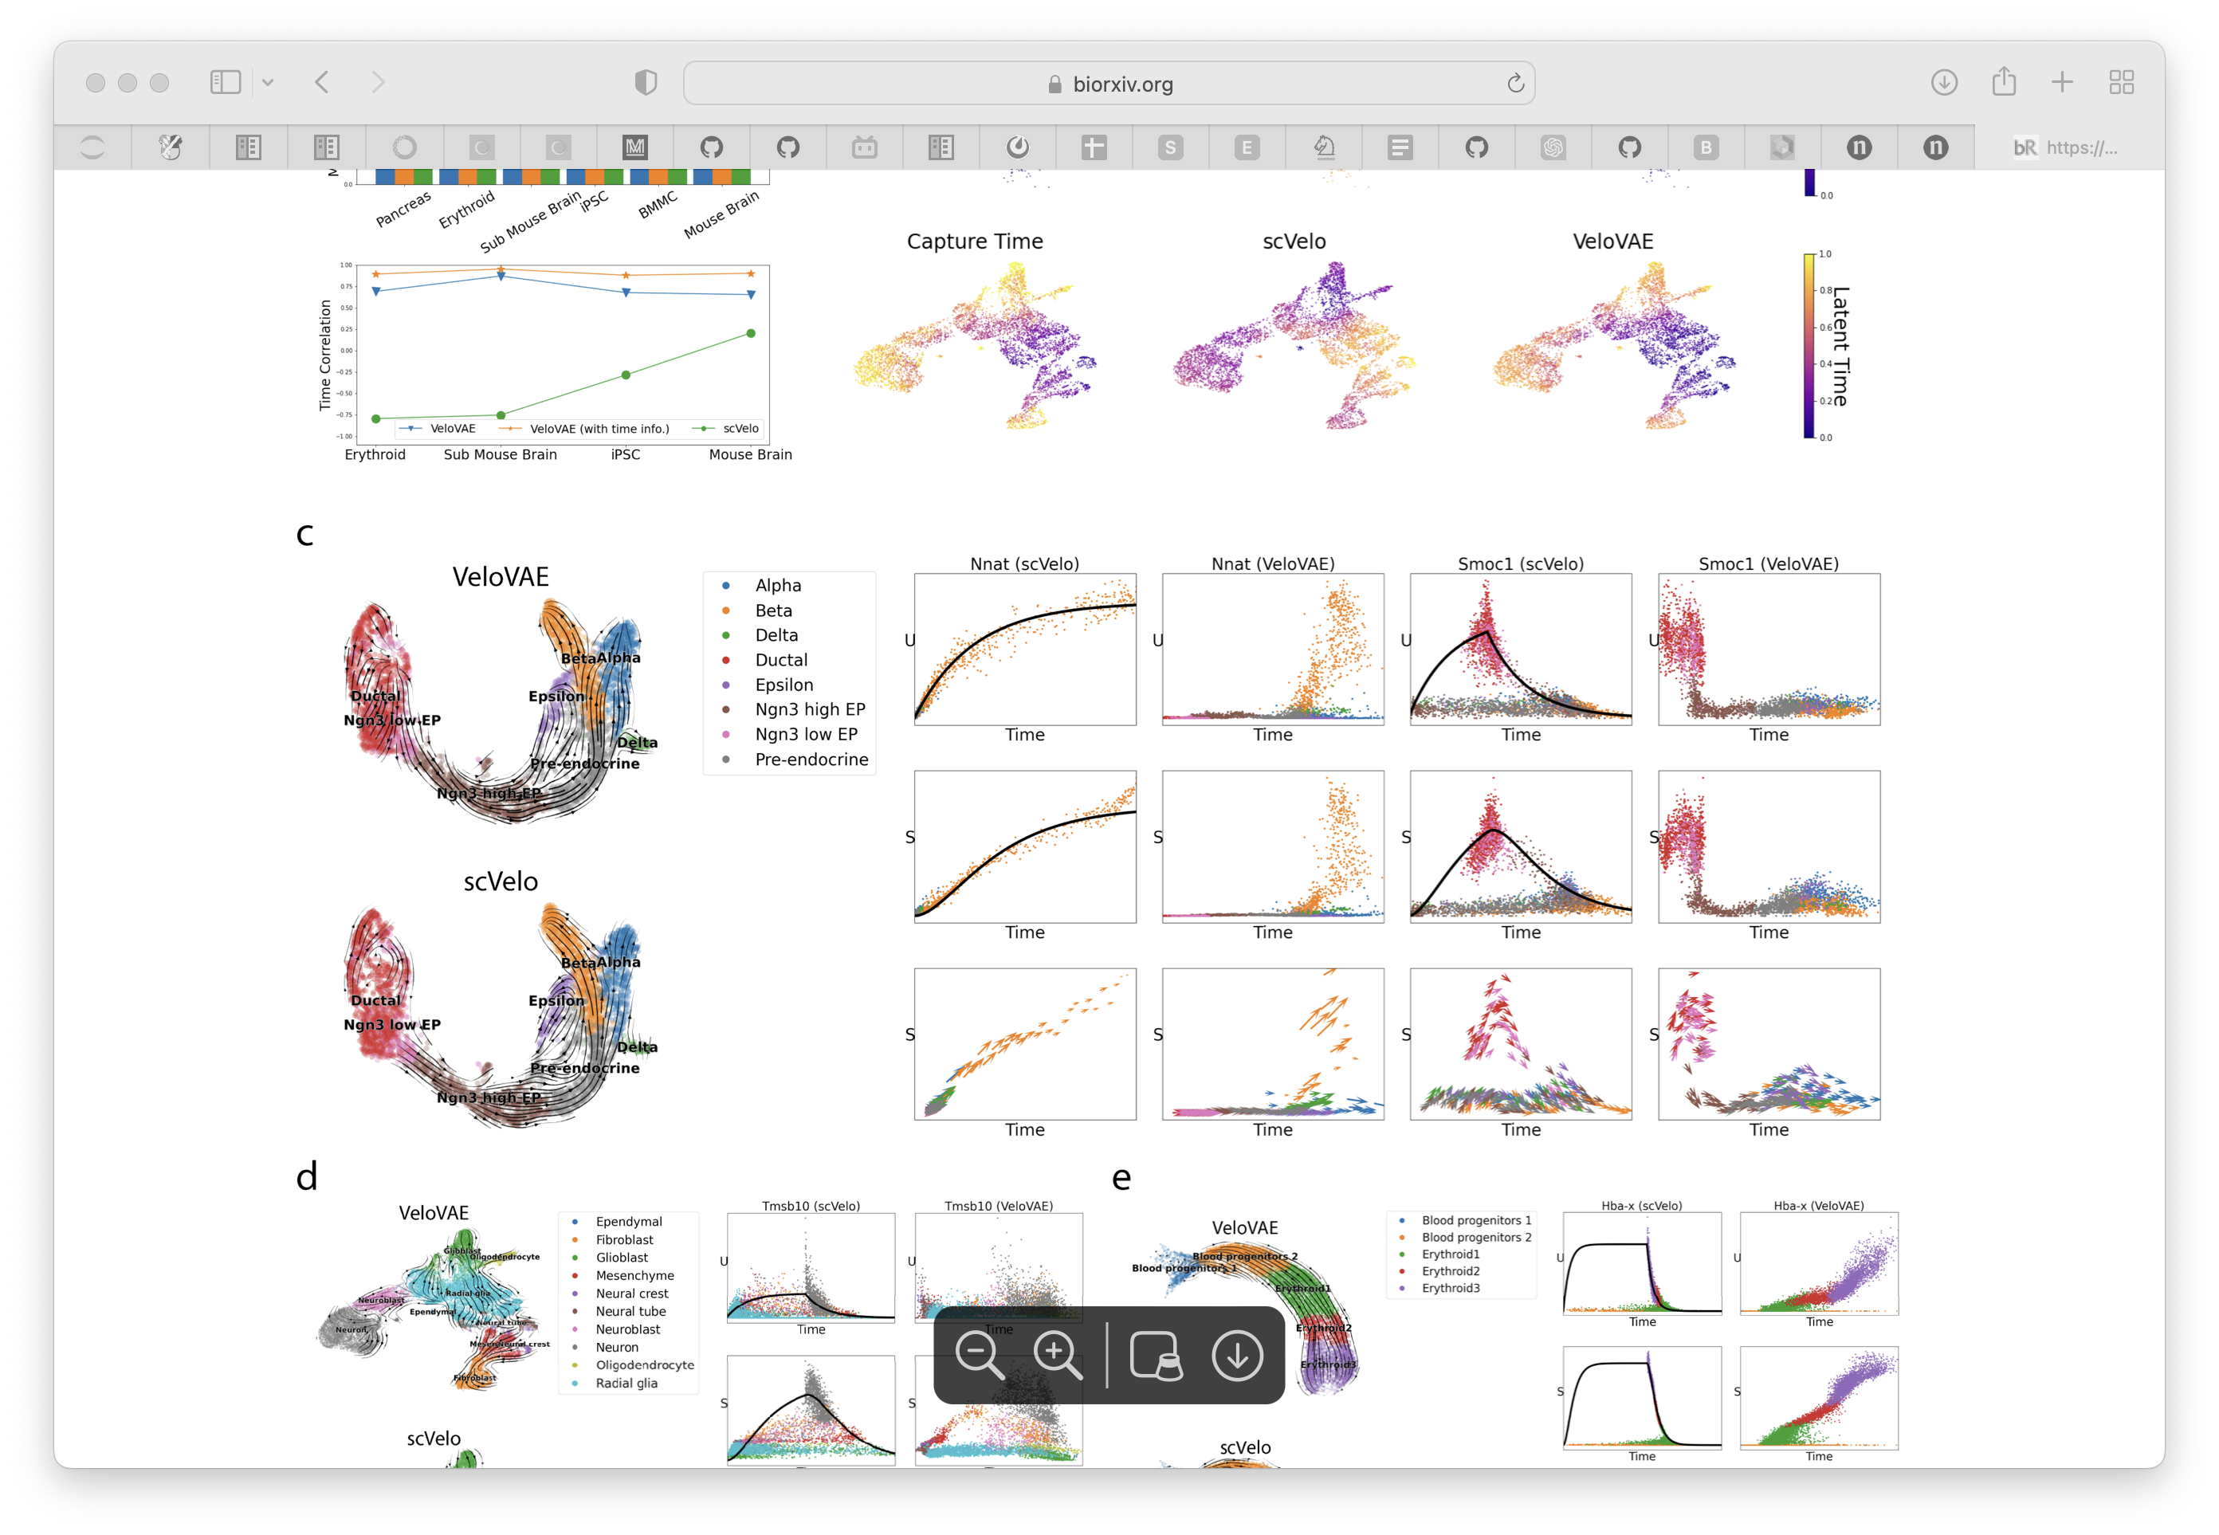
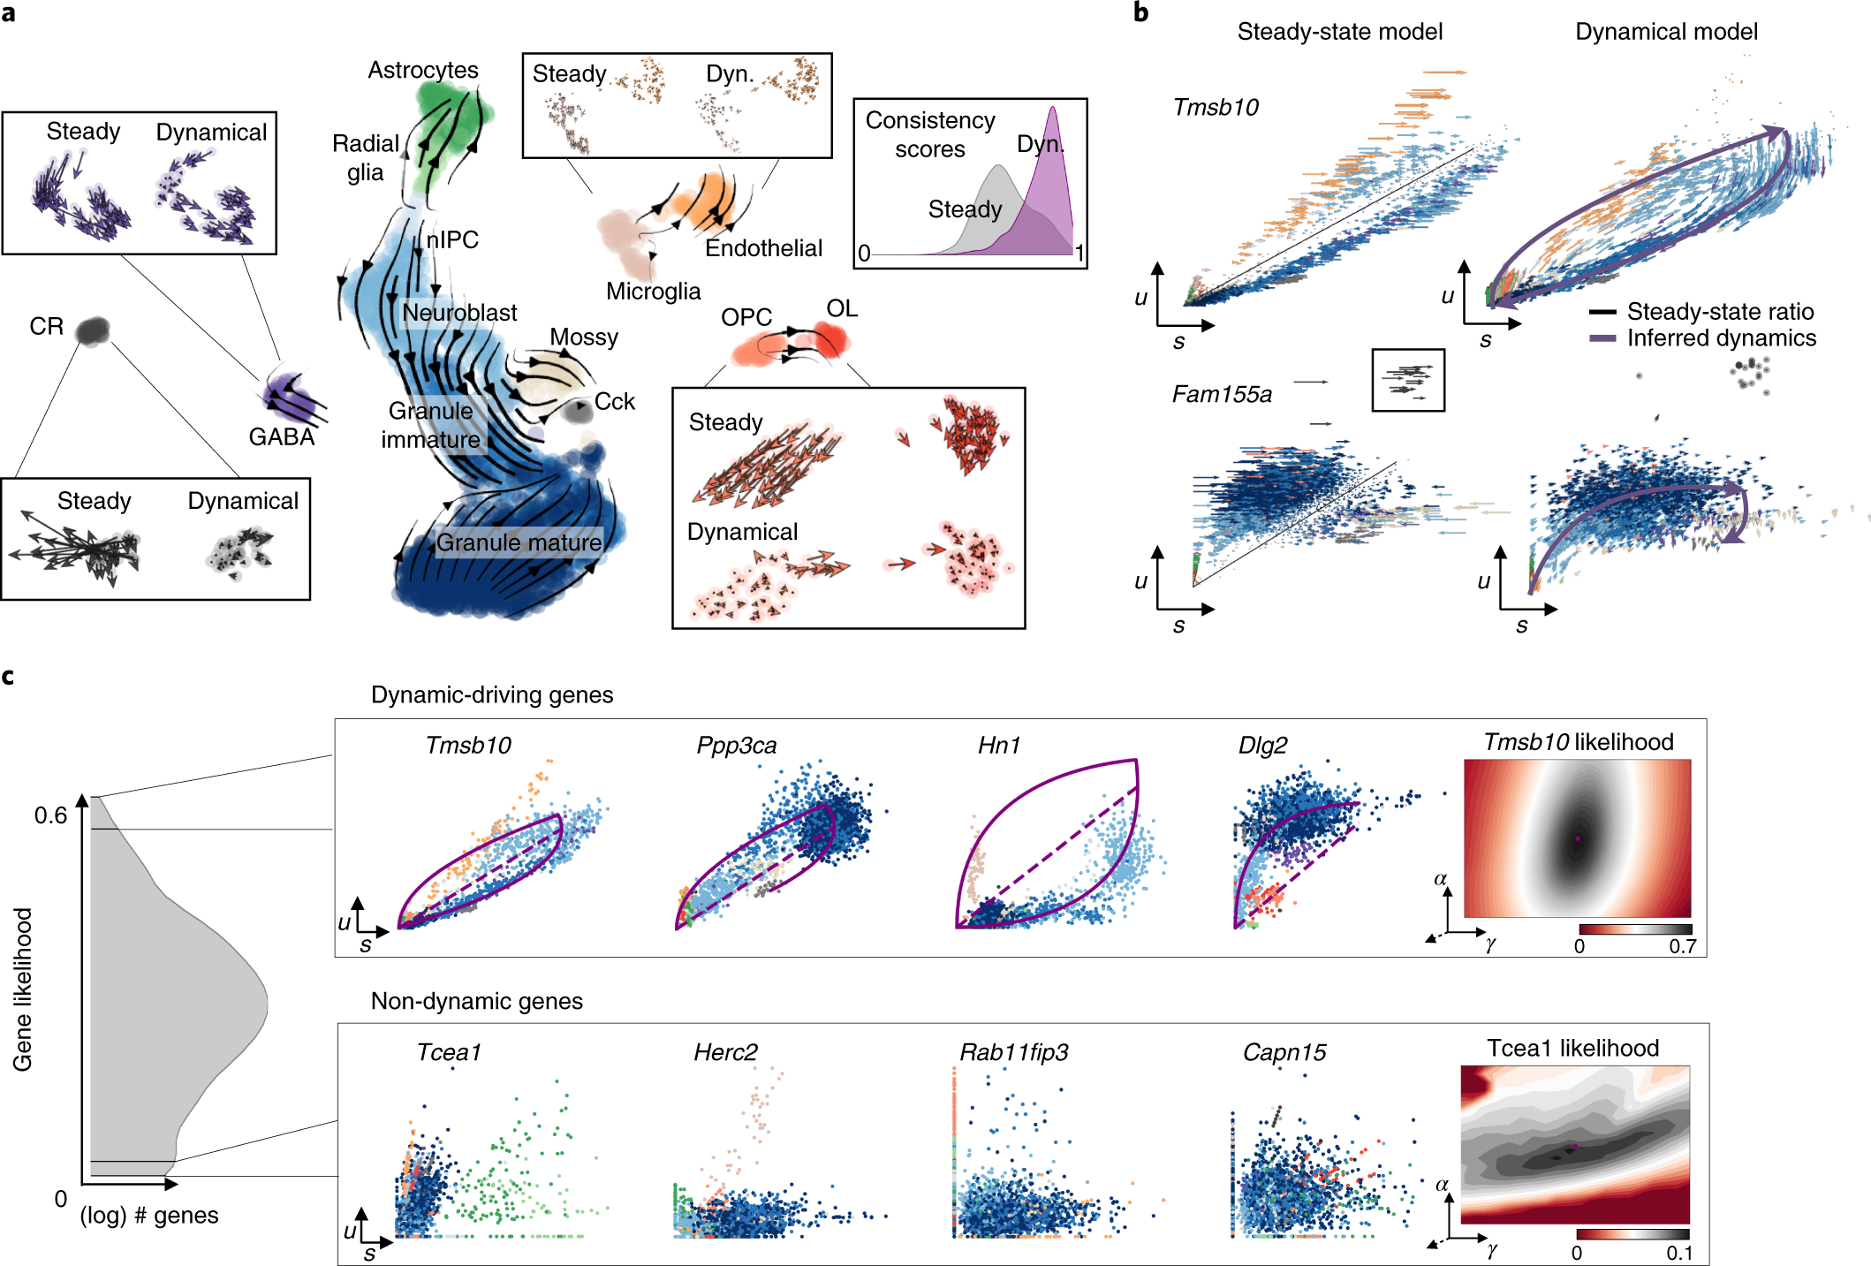

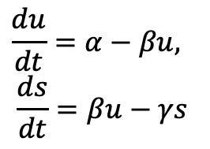
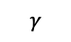
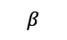
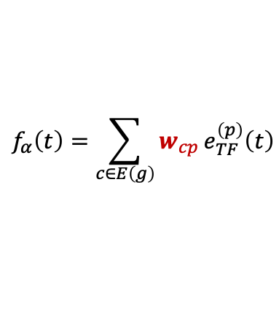
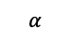
Current limits in RNA velocity
Multivariate Models towards systems dynamics (RegVelo)
TF2
Modeling the regulatory dynamics of target gene
TF1
$$α$$
$$β$$
$$γ$$
$$\frac{du}{dt}=α−βu,$$
$$\frac{ds}{dt}=βu−γs$$
1. Steady state assumption
2. Generalized transient system
CRE1
CRE2
CRE3
Target genes
$$f_{α}\left(t\right)=\sum_{c∈E\left(g\right)}{w_{cp}}e_{TF}^{\left(p\right)}\left(t\right)$$
La Manno, et al. 2019, Weiler, et al. 2022
Bergen, et al. 2020
TF: Transcription Factor
CRE: cis-regulatory elements
*Apply on multiomics dataset
Transcriptional bursting induced by change of transcription rate
Supervised by: Marius & Fabian
Potential application of RegVelo
Bergen, et al. 2021
1. A better velocity estimation and fate probability prediction
later induction
First induction
“First induction” ->
Gene specific latent time -> a heuristic estimation of global latent time
2. Understanding the underlying regulatory mechanisms of lineage differentiation/priming
Gu, et al. 2022
Each gene fit independently, ignoring everything about regulation relationship
3. Generate new trajectory and test the effects of TF-perturbation the lineage differentiation.
Bergen, et al. 2022

Slide 2
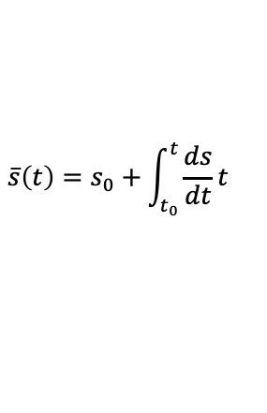
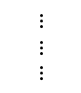
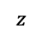
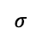
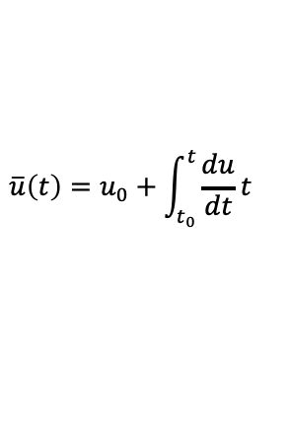
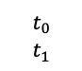
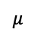
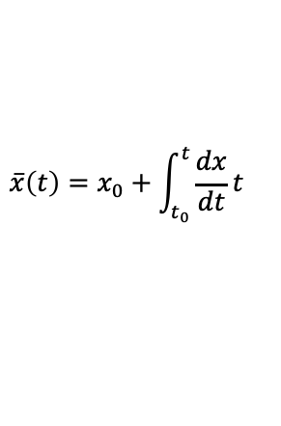
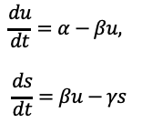
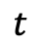
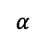
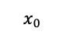
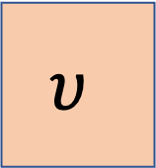
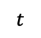
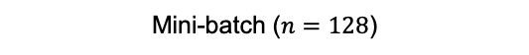
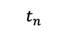
Implementation.1 Use numerical solver
Mini-batch ($n=128$)
Transcription Rate Encoder
$$α$$
$$x_{0}$$
$$\frac{du}{dt}=α−βu,$$
$$\frac{ds}{dt}=βu−γs$$
Numerical solver block
$$\overline{u}\left(t\right)=u_{0}+\int_{t_{0}}^{t}{\frac{du}{dt}t}$$
Spliced
$$\overline{s}\left(t\right)=s_{0}+\int_{t_{0}}^{t}{\frac{ds}{dt}t}$$
$$z$$
$$t$$
$$μ$$
$$t$$
$$t_{0}$$
$$t_{1}$$
$$υ$$
Unspliced
$$⋮$$
$$⋮$$
$$⋮$$
$$σ$$
$$t_{n}$$
Latent Time Encoder
$$\overline{x}\left(t\right)=x_{0}+\int_{t_{0}}^{t}{\frac{dx}{dt}t}$$
$$Loss=ReconstructionLoss+{ReconstructionLoss}_{ODE}+KL divergence$$
$$+{latent space distance}_{z}$$
torchdiffeq.odeint
Use correlation matrix to initialize the transcription rate encoder

Slide 3
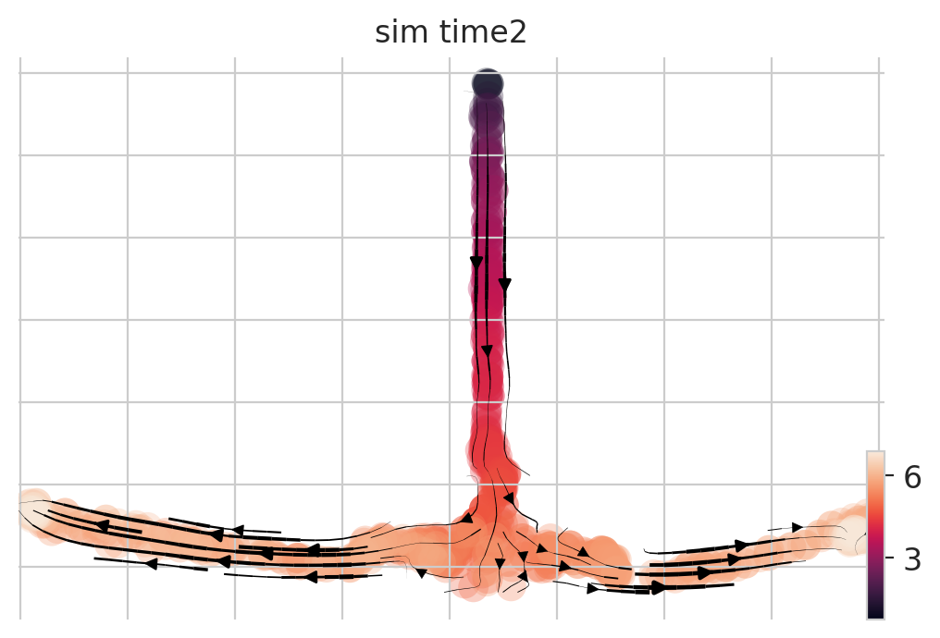
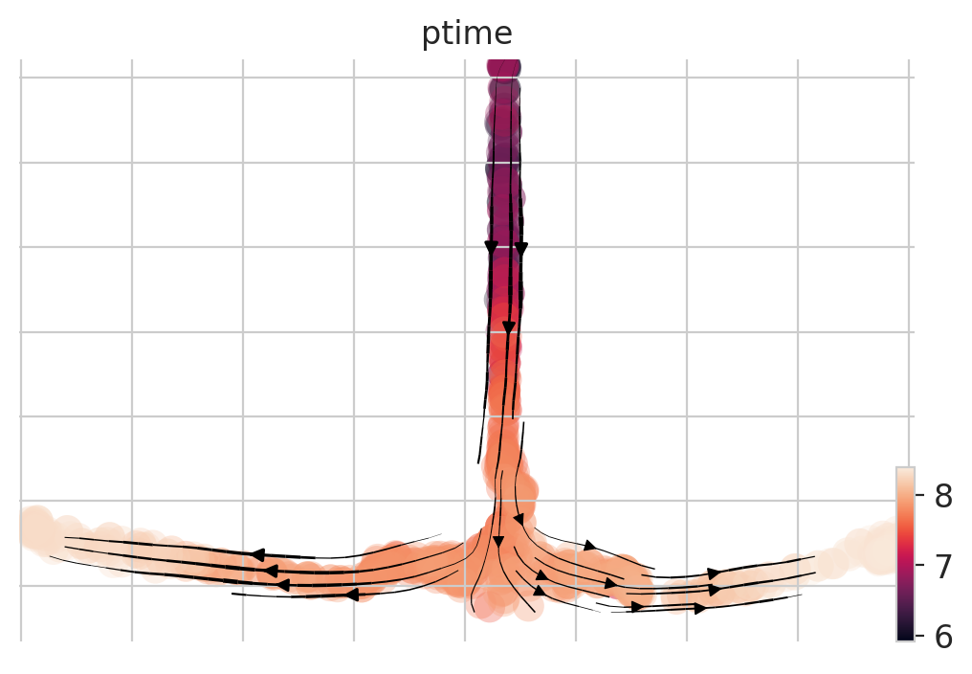
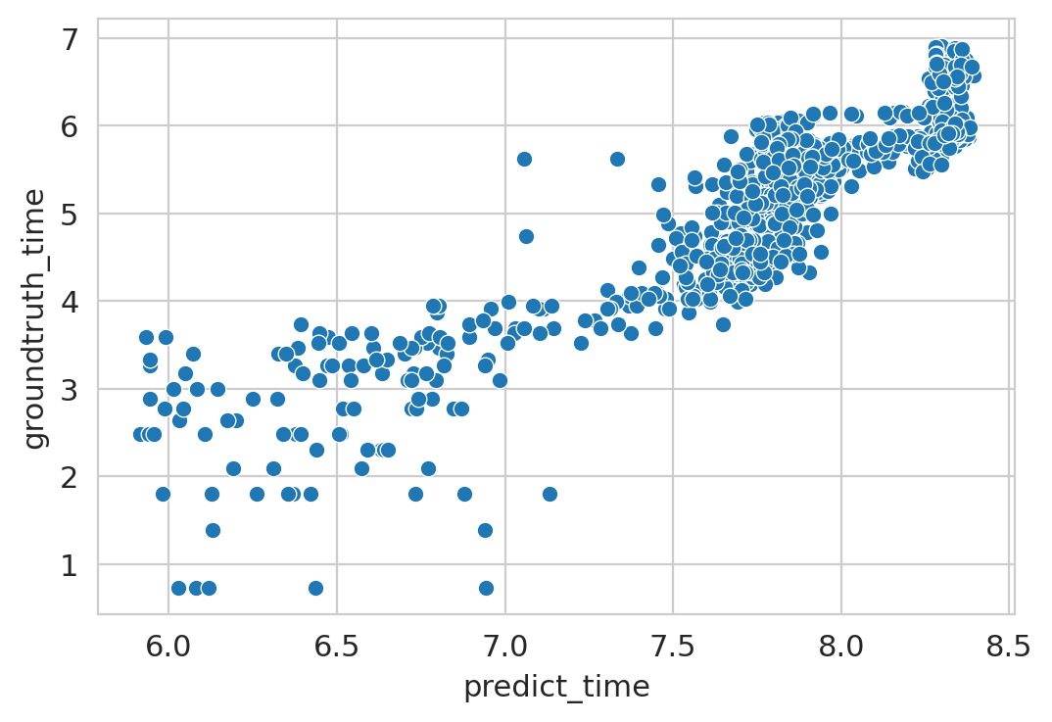
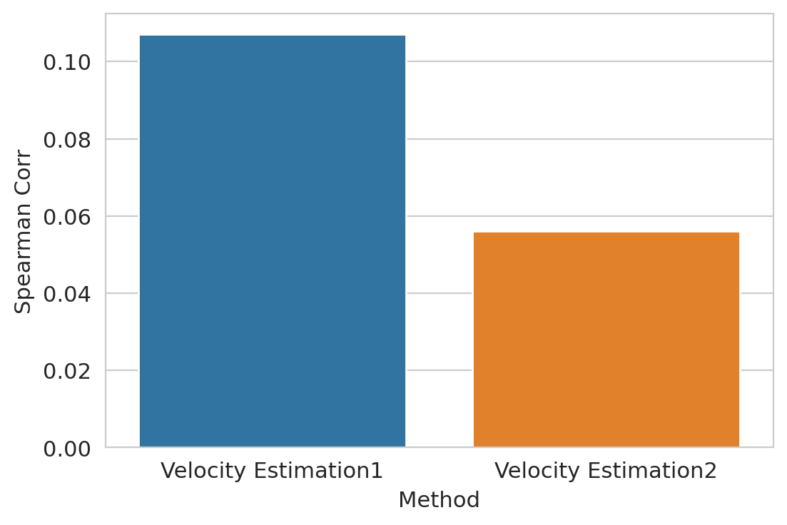
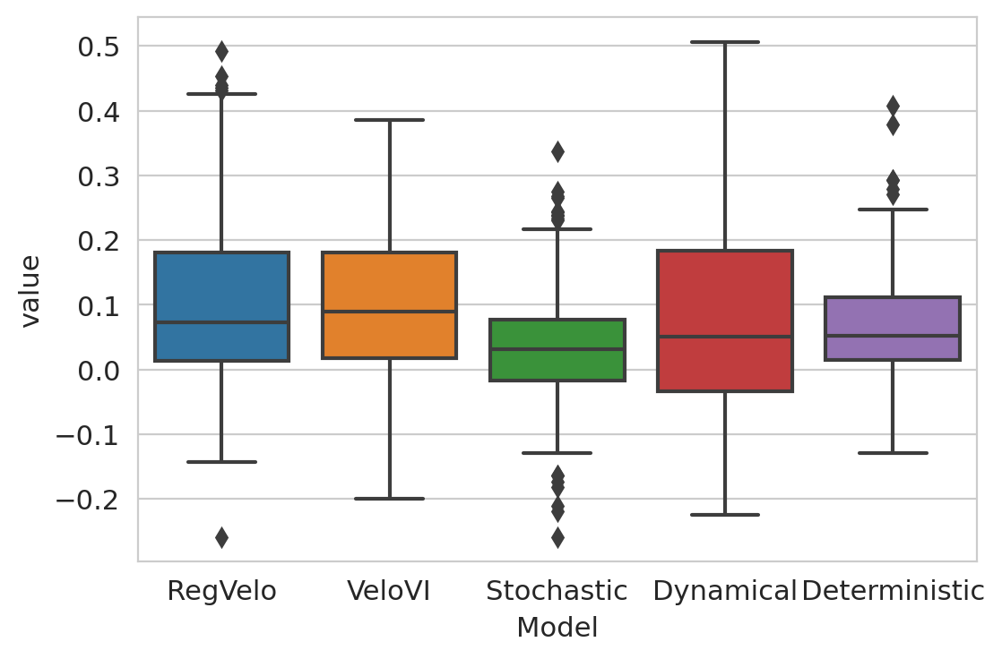
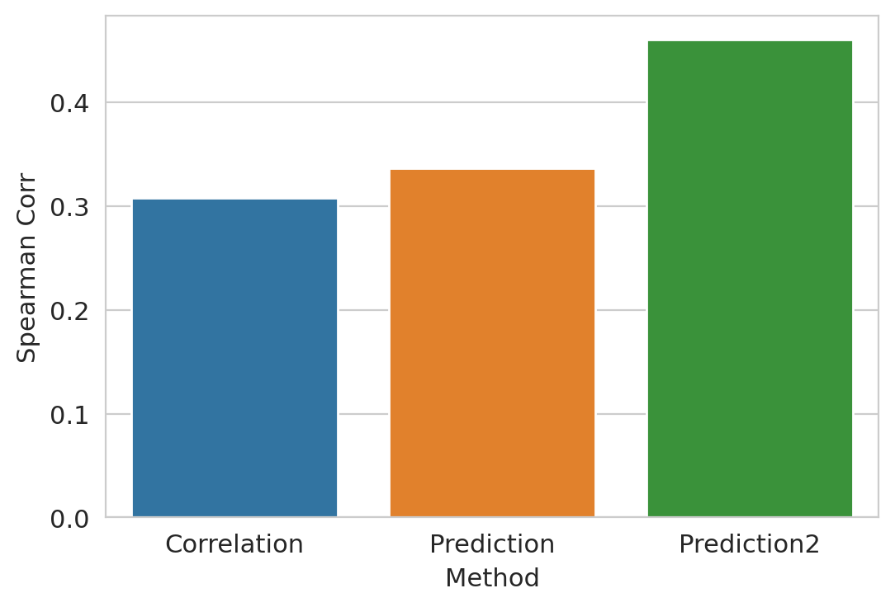
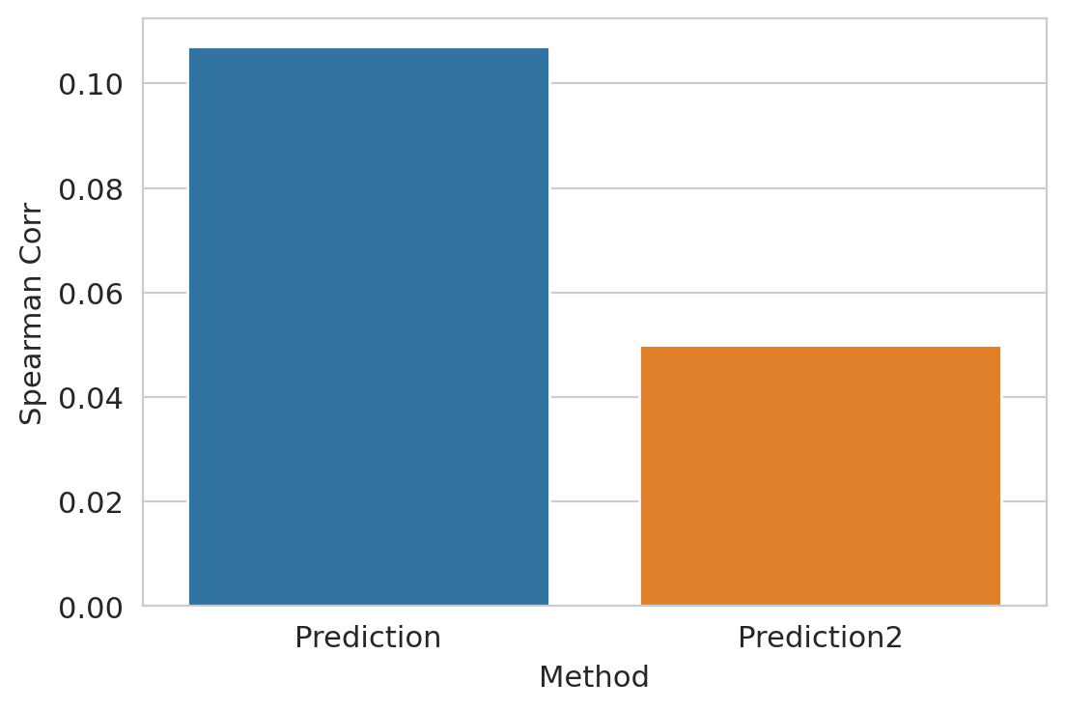
Simulation results
Learning Parameters
theislab/RegVelo
Prediction1: Adam optimizer, LR = 0.01, weight_decay = 0.01, batch size = 128
Use the dyngen to perform simulation
80 TFs, 50 HK genes and 80 Target genes
Prediction2: Adam optimizer, LR = 1e-4, weight_decay = 1e-6, batch size = 64
Ground truth
Prediction
Spearman Cor = 0.89

Slide 4
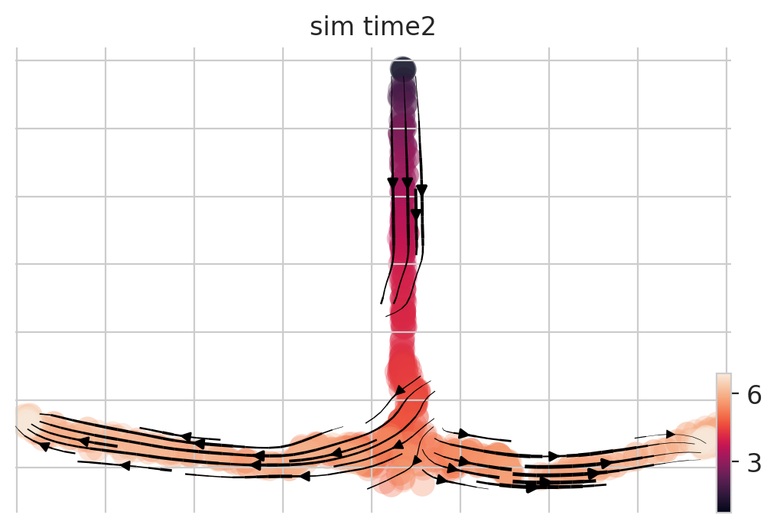
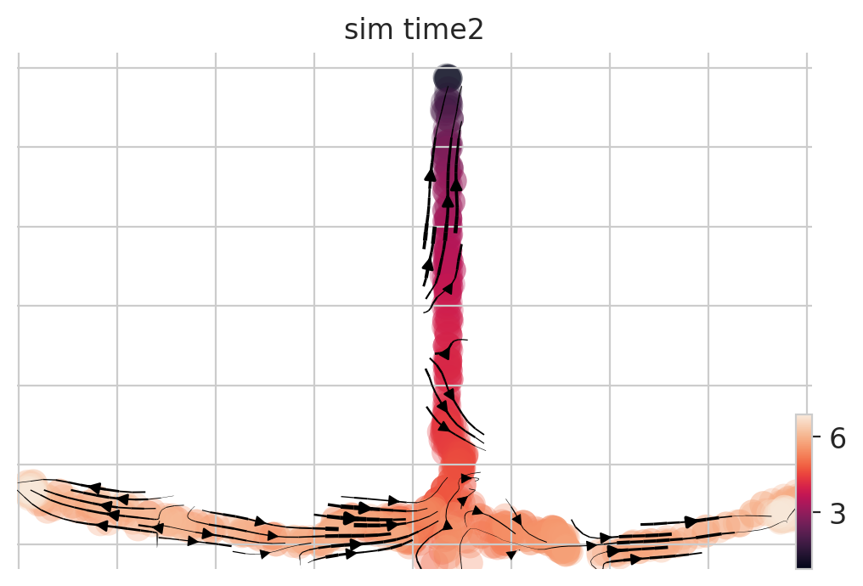
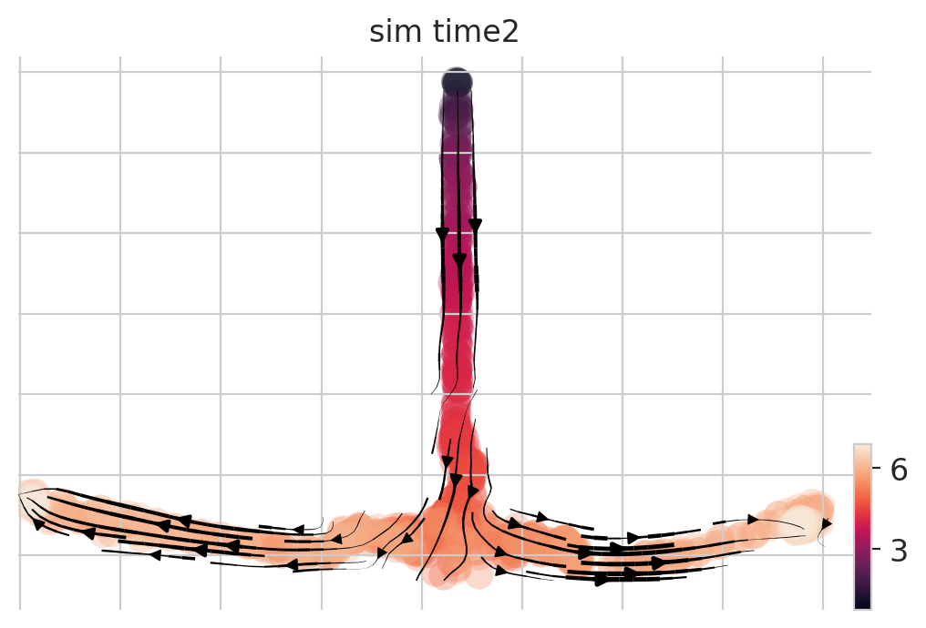
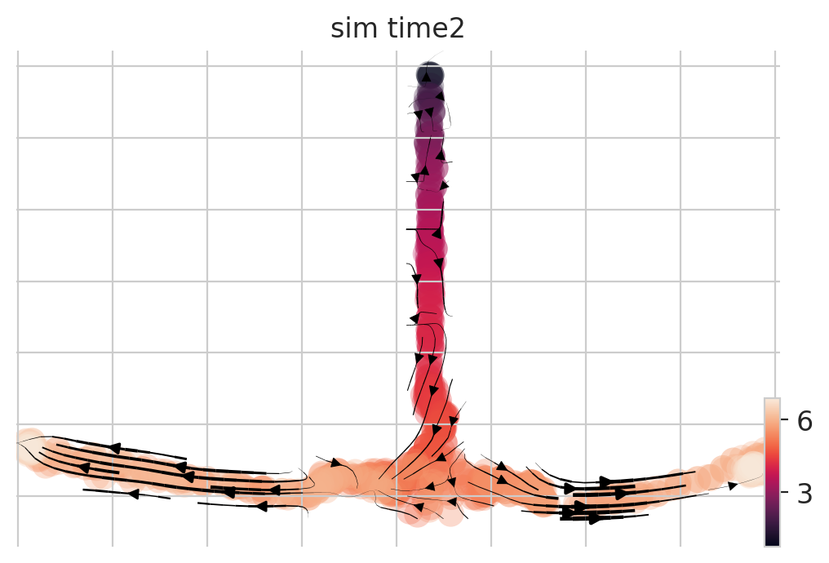
VeloVI
Stochastic
Dynamical
Deterministic

Slide 5
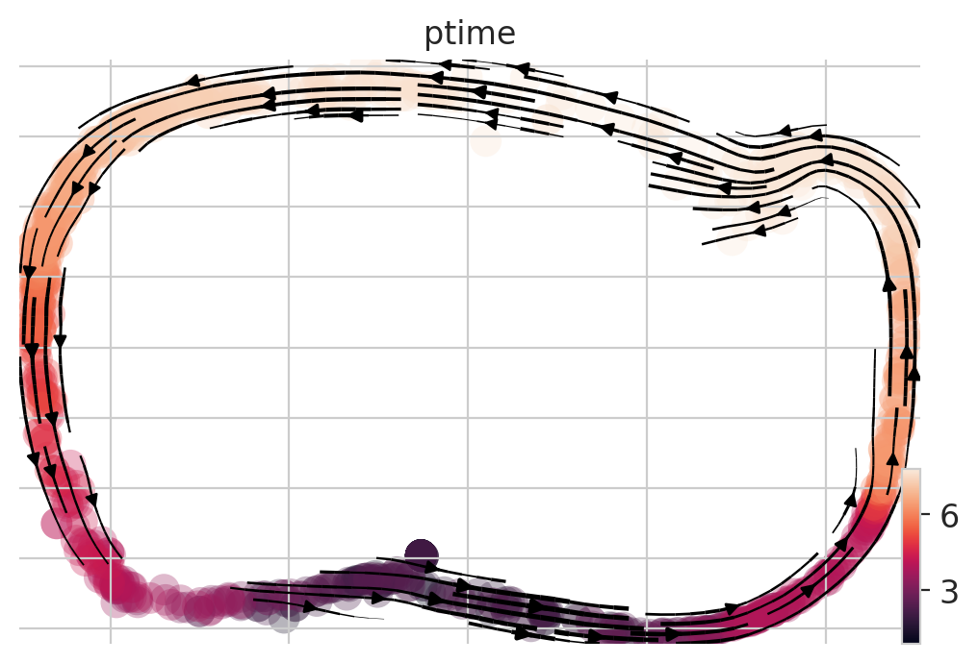
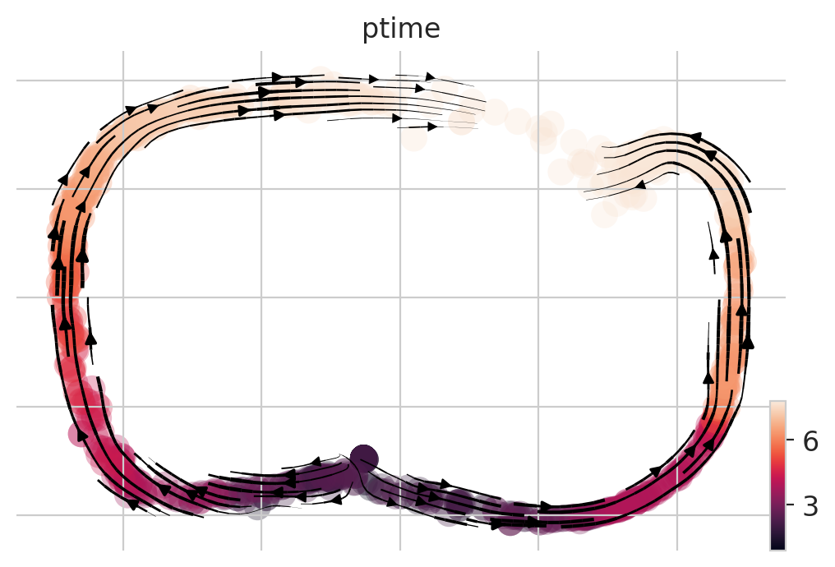
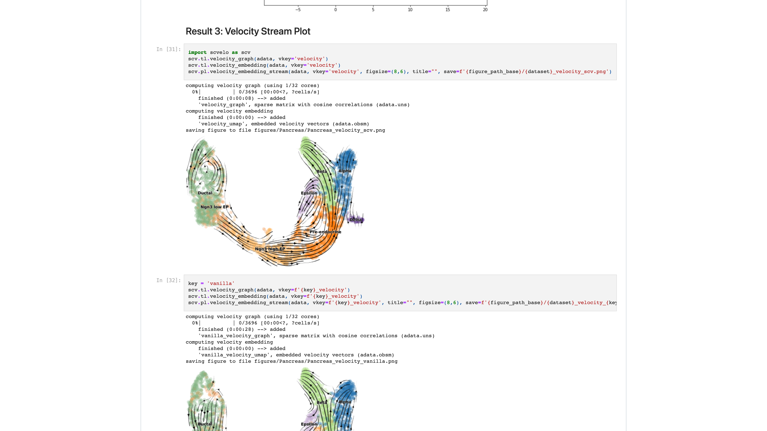
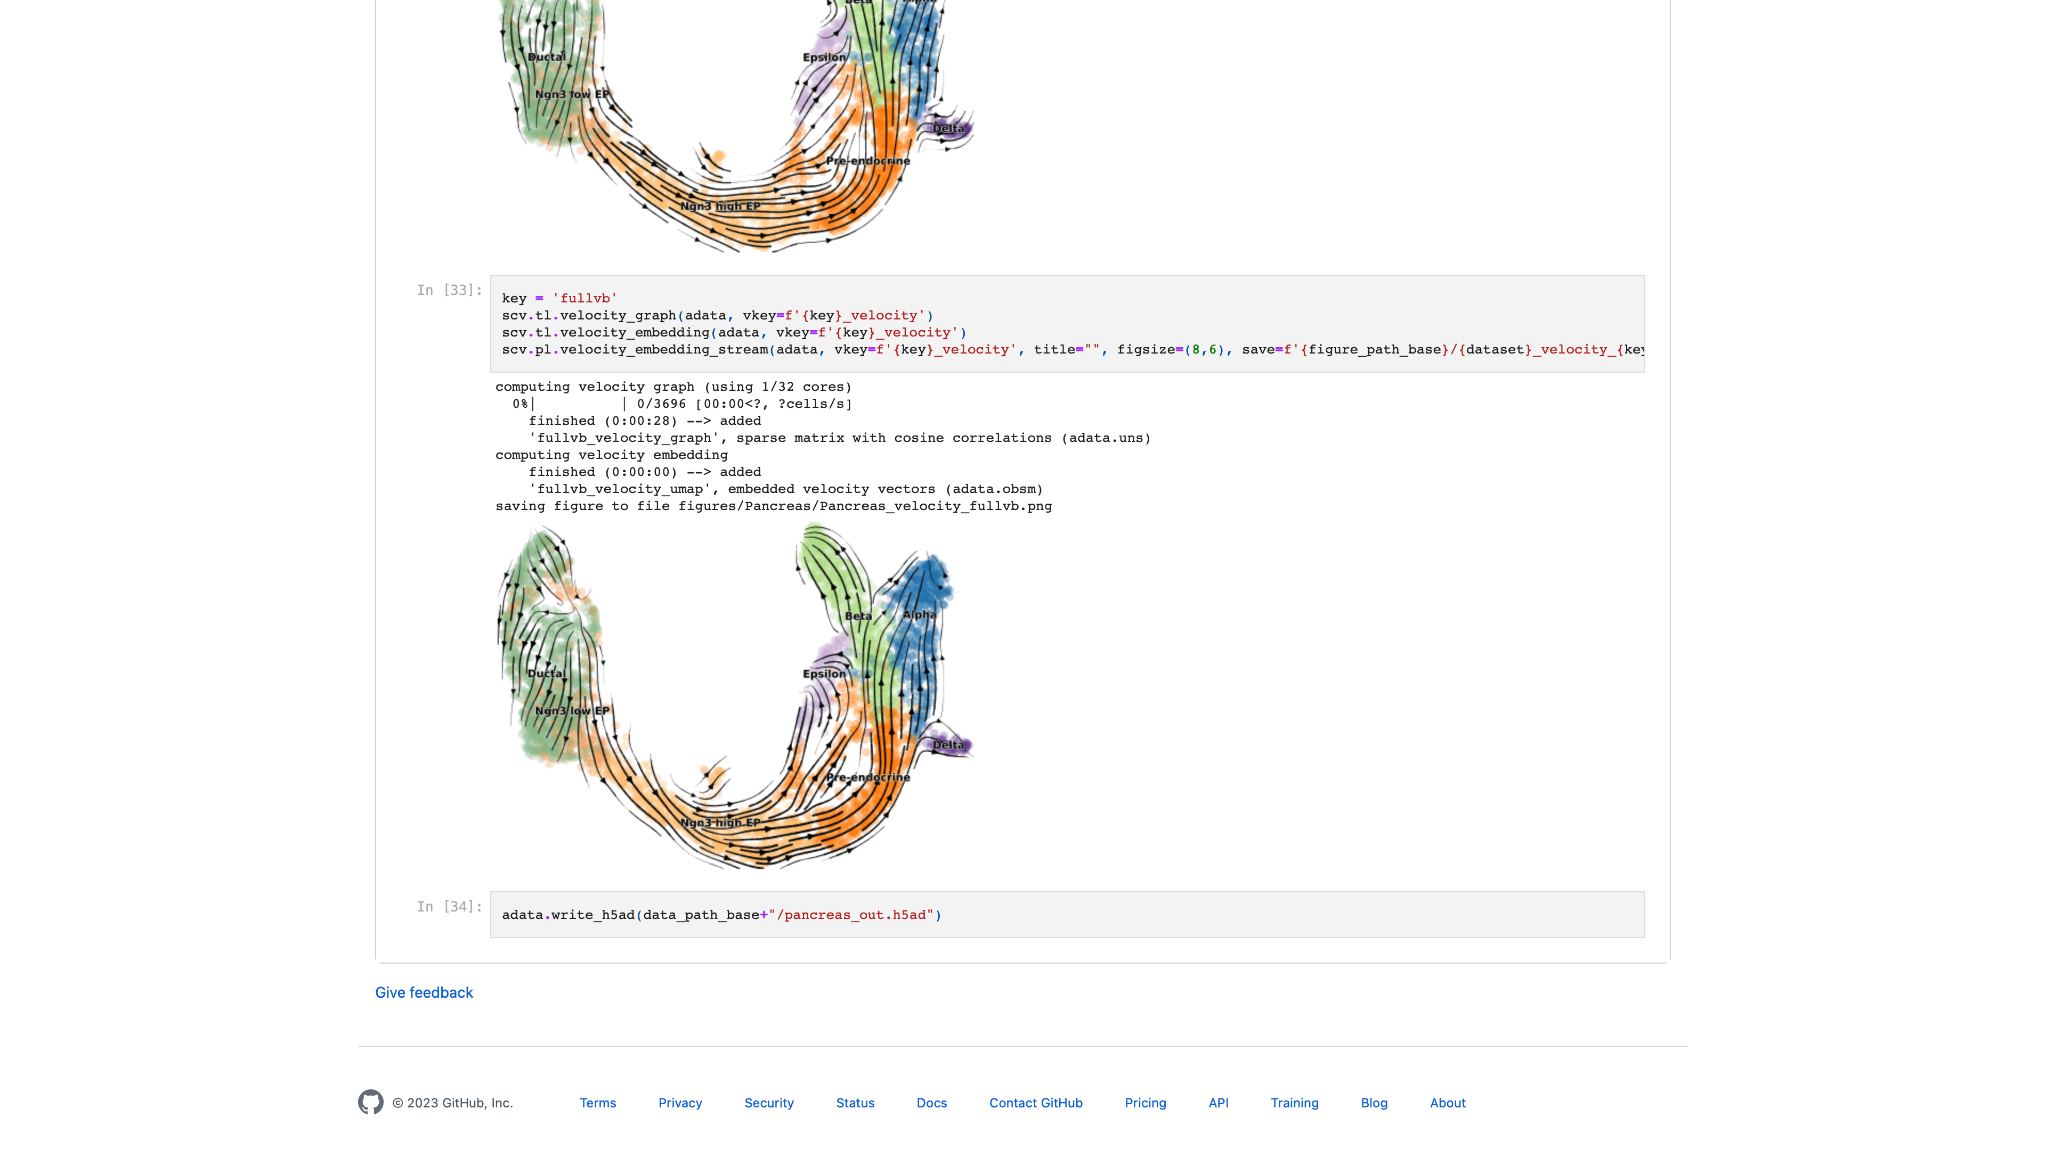
Current Limits of RegVelo
To many Loss term, hard to be trained (need a proper learning rate and batch size)
Need correlation matrix for initialization, otherwise learn nothing relate to GRN
Cost a long time to train (7 mins on 1000 cells and 175 genes)
Numerical solver would not be accurate when need to extrapolate to a long distance (maybe need to learn like VeloVAE, set a small time interval ahead of each time point (cell) as the initialize condition, and then re-train the model)
A unified time cannot learn cycling trajectory!!
…
VeloVI
RegVelo
scVelo
VeloVAE

Slide 6
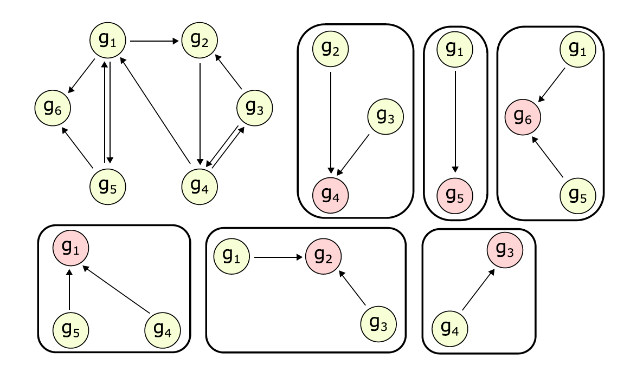
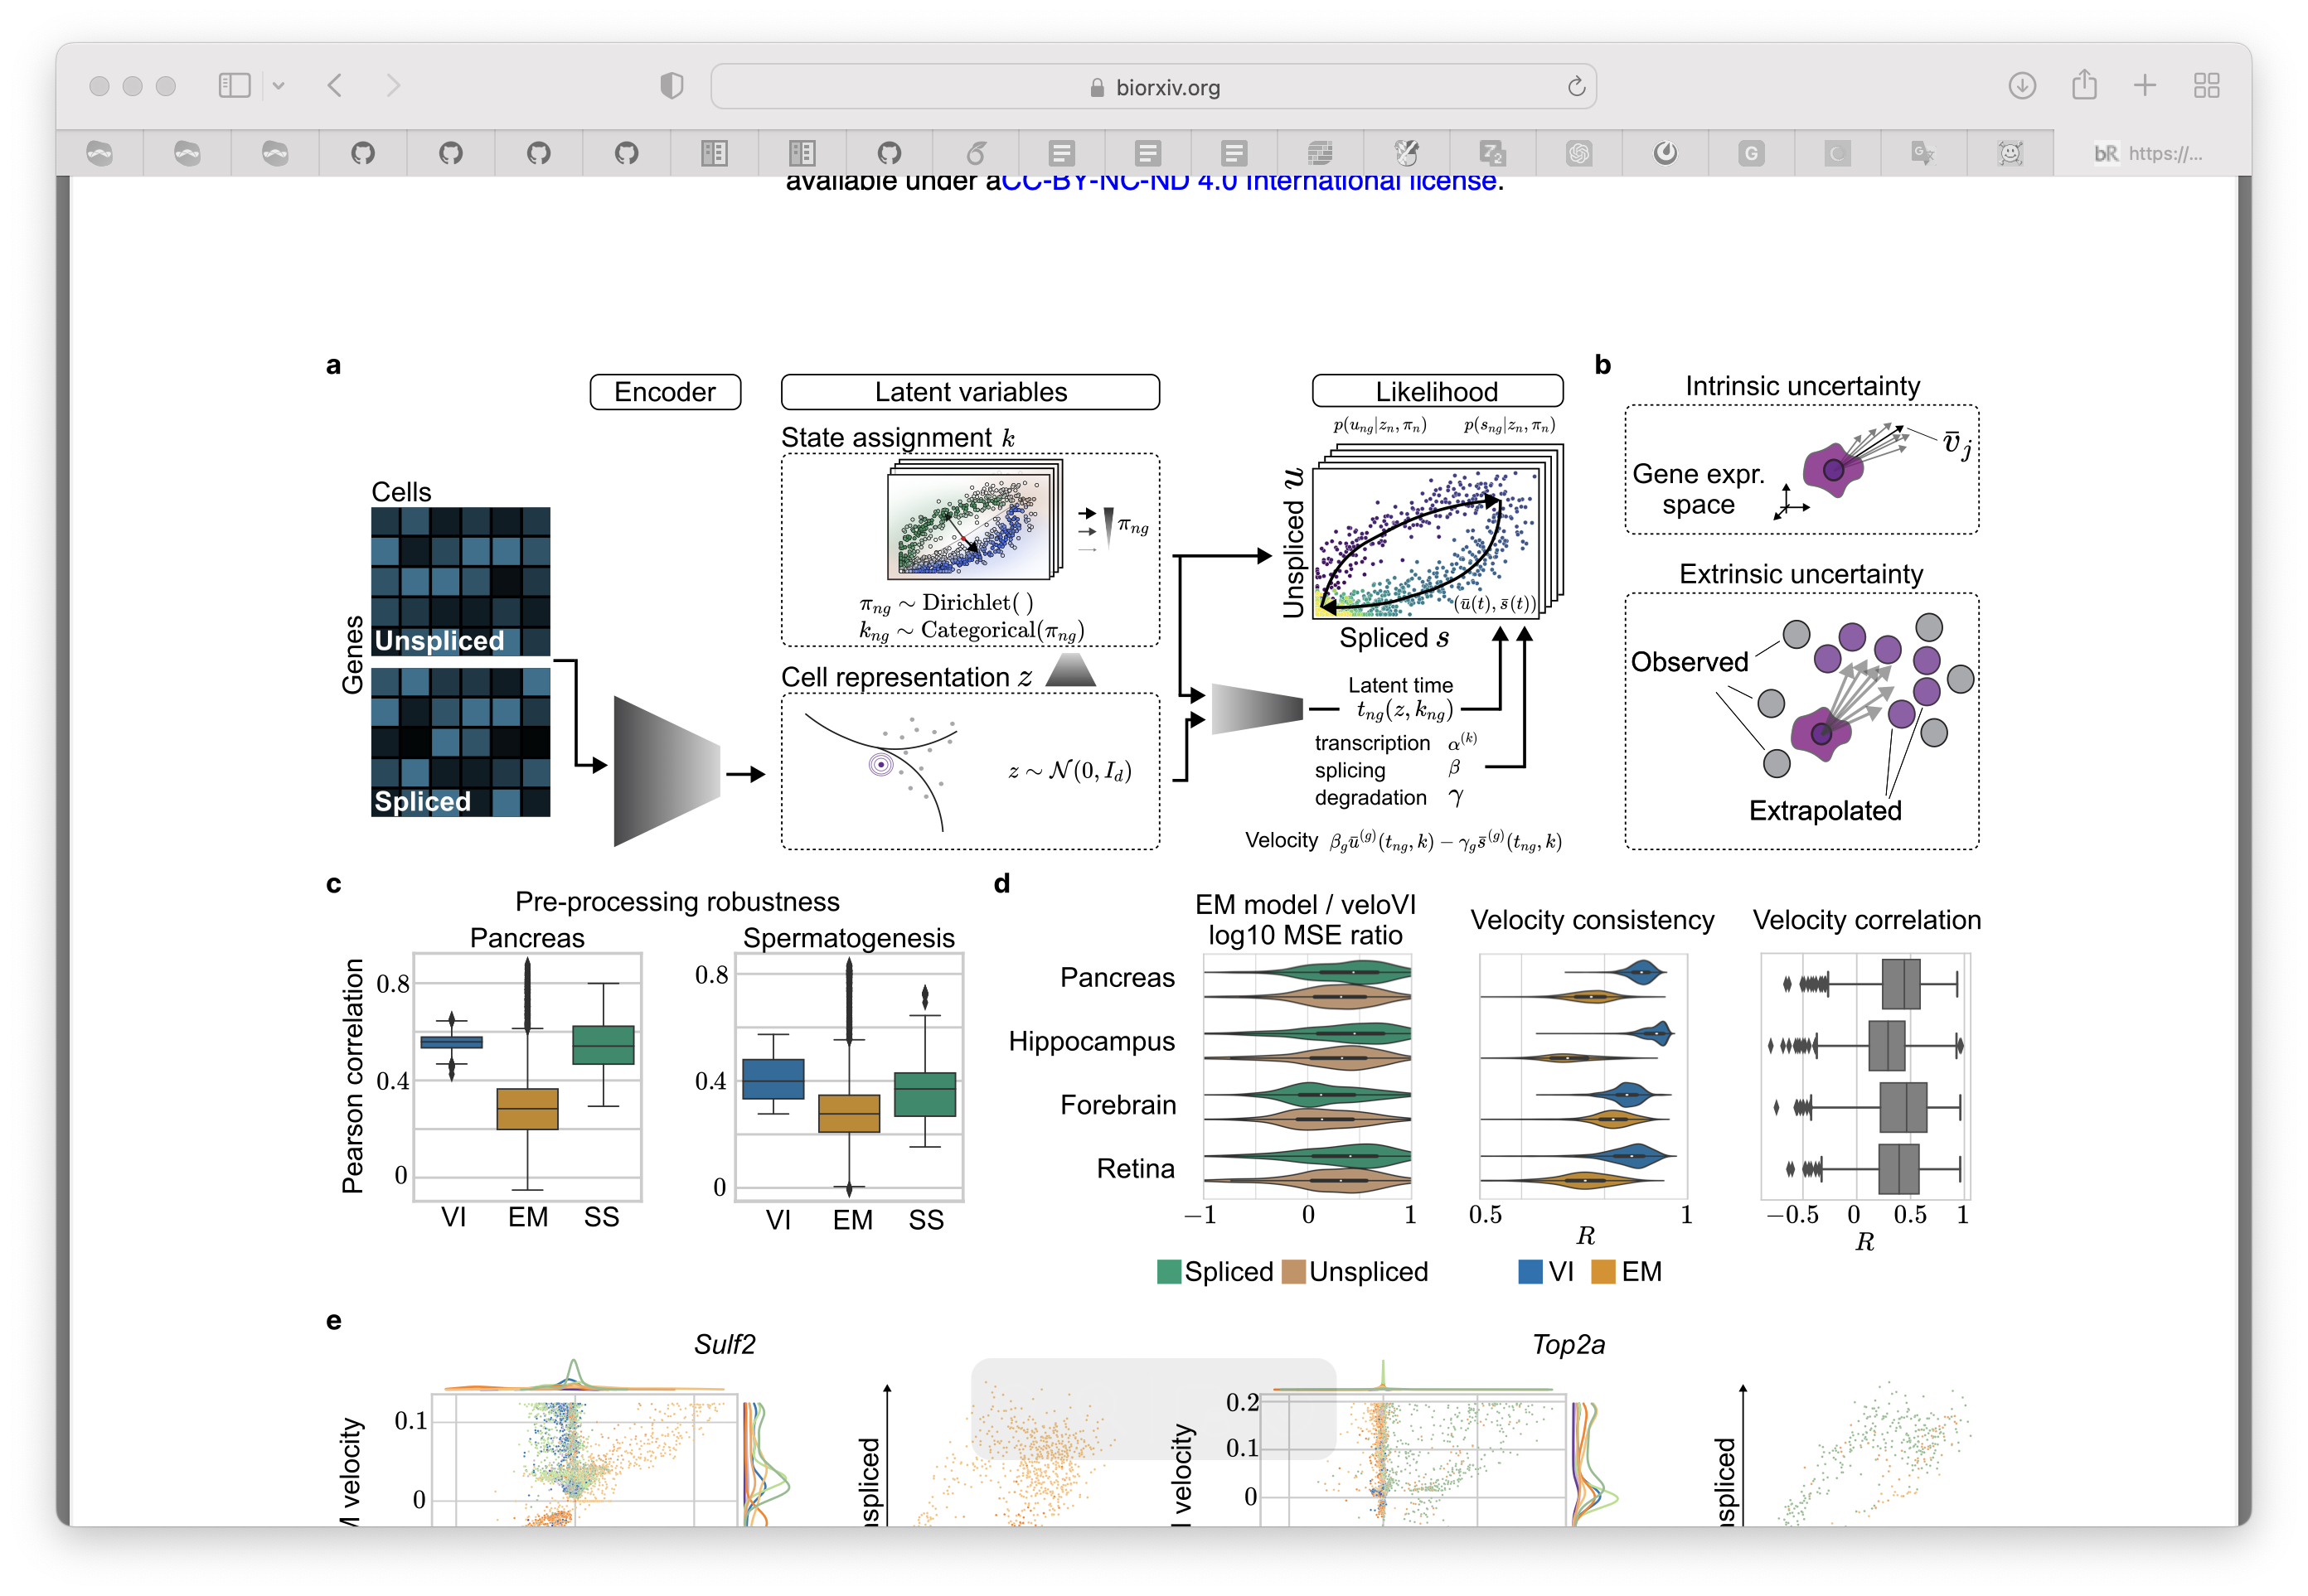
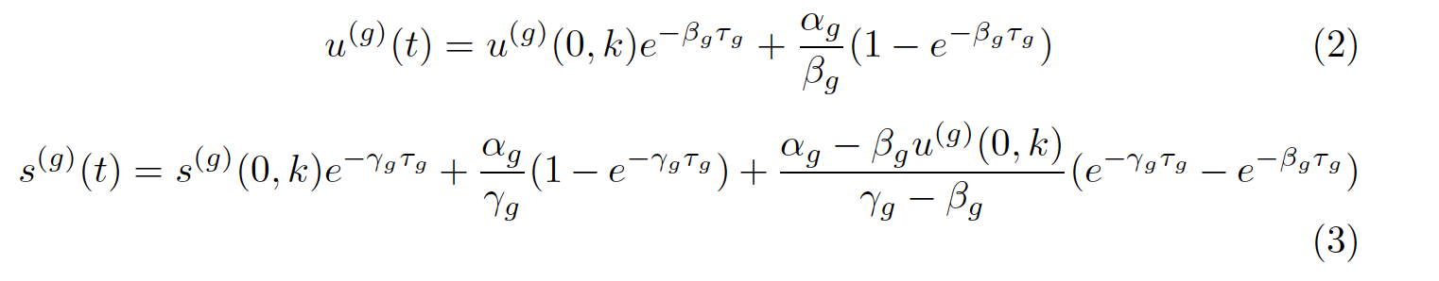
Implementation.2 Analytic solution
Decouple the system using condition independence
Emulator
Keypoints of estimation framework
1. A decoupled systems
Gene (velocyto, scVelo) -> Regulon (RegVelo)
2. Building on flexible VeloVI framework
Recap of VeloVI estimation framework
Decouple into “regulons”:
A target gene and a set of regulators(TF & CREs)
Georgoulas, et al. 2012
Estimation procedure:
1. Initialize using scVelo, velocyto (or MongeVelo?) to get the initial estimation of latent time.
2. Interpolate the dynamics of the regulators use top-down manner (emulators) using parametric function (RBF) or Gaussian process.
3. For each subsystem, estimate kinetic parameter and regulatory parameters
4. In the meantime, regularize the solution of regulator (TF and CRE) need to be same to the interpolation
5. Updating until converge.
Gayoso & Weiler, et al. 2022

Slide 7
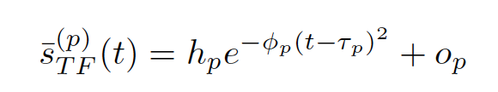


Estimation procedure:
1. Interpolate the dynamics of the regulators use top-down manner (emulators) using parametric function (RBF) or Gaussian process.
2. For each subsystem, estimate kinetic parameter and regulatory parameters

Slide 8


Gao et al., 2022

Slide 9





Interpolate regulator dynamics
Likelihood
ATAC
Spliced
$$z$$
$$μ$$
$$t$$
$$σ$$
Unspliced
Latent time encoder
Assume all decoded modality follow Gaussain distribution

Slide 10


Slide 11


















Decouple the network through Modularization
Emulator Module
Velocity Encoder Module
Numerical Solver Module
$$h$$
$$α$$
$$\overline{u}\left(t\right)=u_{0}+\int_{t_{0}}^{t}{\frac{du}{dt}t}$$
$$φ$$
$$W$$
$$φ$$
$$\frac{du}{dt}=α−βu,$$
$$\frac{ds}{dt}=βu−γs$$
$$τ$$
$$O$$
$$h$$
$$O$$
$$\overline{s}\left(t\right)=s_{0}+\int_{t_{0}}^{t}{\frac{ds}{dt}t}$$
Parallel ODE solver
Spliced
# cells
$$μ$$
$$z$$
Regulon Specfic
Latent time
Unspliced
# target genes
$$σ$$
Cell Representation Encoder
Latent Time Decoder
Fit Likelihood
To the parameter of h, phi, tao, O, all four need broadcast to form a matrix with (t*g), (or if we need to model target gene specific regulation)
We also could just fit a matrix with (t*g) without broadcast to fit a target gene specific regulator coefficient. Then infer a module specific latent time.

Slide 12
recon_loss_reg = F.mse_loss(regulator_spliced, emulation, reduction='none').sum(-1).mean()
recon_loss_target = F.mse_loss(target_unspliced, pred_u, reduction='none').sum(-1).mean() + F.mse_loss(target_spliced, pred_s, reduction='none').sum(-1).mean()
kl_div = normal_kl(qz_m, qz_logvar, pz_mean, pz_logvar).sum(-1).mean()

Slide 13


